Slide 1


Slide 2
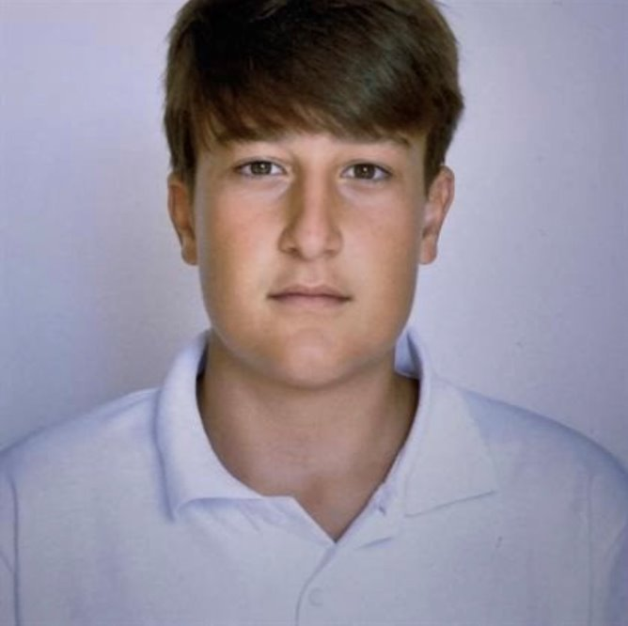




Our Team
Maxim Mateev
Ivan Ivanov
Stefan Dimitrov
Gabriel Yanchev
Tsvetomir Stoilov
Frontend Developer
Backend Developer
SCRUM trainer
Designer
Frontend Developer

Slide 3









Used technologies

Slide 4
About our project
CarFinders is a modern web platform designed to help users find the perfect car based on their needs. By leveraging Natural Language Processing (NLTK), the site analyzes reviews to match vehicles with specific needs and preferences.

Slide 5
So let's get into the project
🚗💨

